Slide 1
Superstore Sales Performance Dashboard
Sales Performance | Regional Insights | Product Analytics | Strategic Recommendations
Vivian Okoaze
Sales & Product Analyst
Date and tool used: Power BI | 2014–2017

Slide 2
DATASET OVERVIEW Understanding the superstore dataset structure and scope
9,994
21
4
None
Total Records
Columns
Years Covered
Missing Values
Total Rows
Features
2014–2017
Clean Data
Key Column Groups
Identifiers | Order ID, Customer ID, Row ID
Product Information | Category, Sub-category, Product Name
Date Fields | Order Date, Ship Date
Logistics | Ship Mode, Segment
Geography | Country, Region, State, City, Postal Code
Financials | Sales, Quantity, Discount, Profit

Slide 3
BUSINESS PROBLEM What questions does this dashboard answer?
Which regions and products drive the most profit?
Which customers are most valuable?
Is delivery performance meeting expectations?
Where are we losing money?
Which customer segments generate the highest value?

Slide 4
KEY PERFORMANCE INDICATORS (KPI) 9 critical metrics powering the superstore dashboard
$2.30M
$286K
5,009
12.5%
$458.61
Total Revenue
Total Profit
Total Orders
Profit Margin
Avg Order Value
Sum of all sales across 4 years
Net profit after discounts & COGS
Unique order transactions
Profit ÷ Revenue × 100
Revenue ÷ Total orders
793
38k
3-4 Days
3,999
Total Customers
Total Quantity
Average Delivery Days
Delayed Orders
Distinct count Customer ID
Total Quantities Ordered
Average Delivery Timeline
Orders Delivered After The Average Delivery Timeline

Slide 5
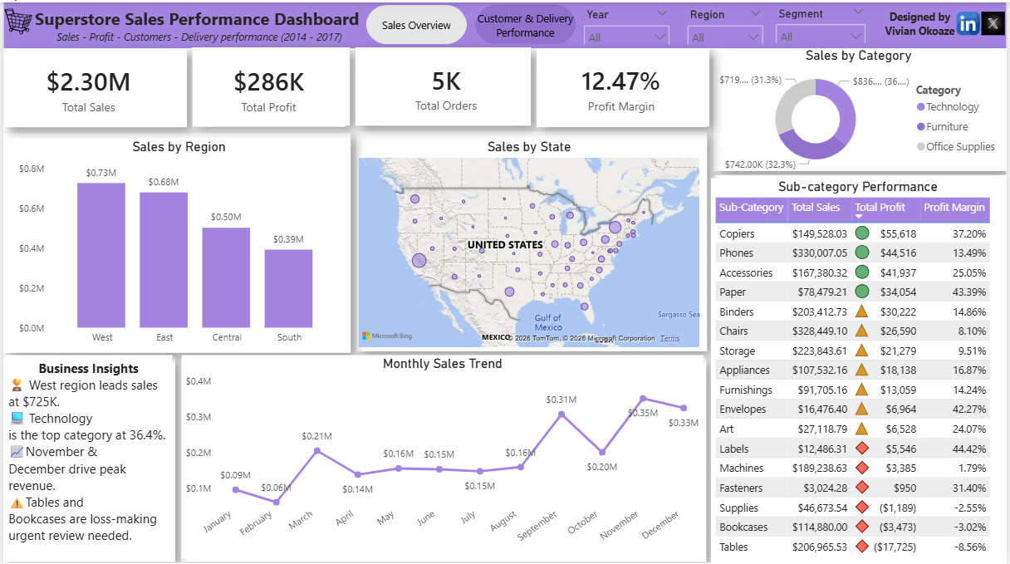
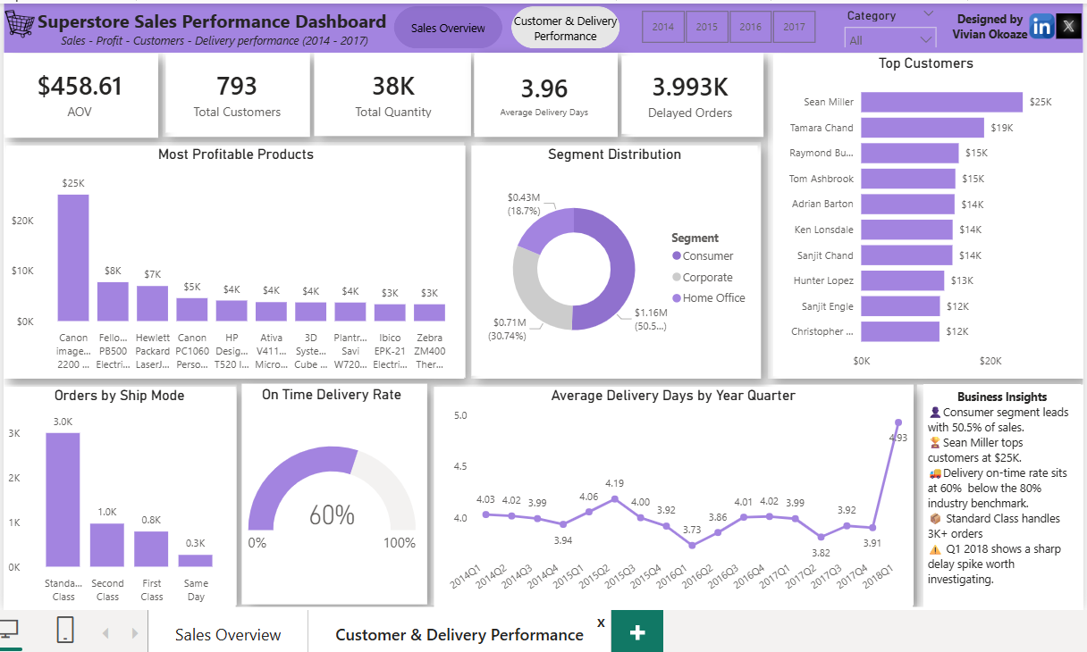
SUPERSTORE SALES PERFORMANCE DASHBOARD LAYOUT Dashboard pictures
West leads all regions
Tables losing money
Technology is best category
Sean Miller top customer at $25K
60% on-time rate needs improvement
Q1 2018 delivery spike

Slide 6
KEY INSIGHTS Superstore sales performance
Total revenue is $2.30M across 4 years with a 12.47% profit margin.
While sales grew consistently from $484K in 2014 to $733K in 2017 a 51% increase the profit margin remains thin, meaning the business is growing in volume but not necessarily in efficiency.
November and December consistently spike 35–40% above monthly average every year. The business is heavily dependent on holiday season demand.
West region generates highest revenue at $725K
Technology is most profitable category at 36.4%
Tables sub-category loses -8.56% needs review
Consumer segment drives 50.5% of all sales
Delivery on-time rate is 60% below 80% benchmark

Slide 7
RECOMMENDATIONS Data- driven actions to improve business performance
Cap discounts on Furniture at 20% maximum. Orders with discounts above 30% consistently generate negative profit.
Invest more marketing budget in Technology
Review Table and Bookcase product line
Investigate Texas high sales but negative profit
Improve Standard Class delivery process
Focus retention efforts on top 10 customers
Promote Same Day and First-Class shipping.

Slide 8
CHALLENGES FACED Obstacles encountered during the project and how they were resolved
During this project, I faced challenges related to data cleaning, DAX measures creation, time intelligence calculations, map visualization issues and dashboard design optimization.
These challenges improved my understanding of Power BI modelling, data preparation and effective business storytelling through dashboards.

Slide 9
CONCLUSION What This Project Demonstrates
This analysis reveals that:
The Superstore is growing in revenue but leaving significant profit on the table through over-discounting, loss-making product lines and below-benchmark delivery performance.
Fixing the discount policy alone could recover an estimated $80K+ in annual profit.
Paired with targeted investment in Technology and Corporate customers, the business has a clear path to both higher revenue and healthier margins.
The insights provide a clear roadmap for improving both revenue and operational efficiency.

